Slide 1

The Islanders
There are two beautiful yet remote islands in the south pacific. The Islanders born on one island always tell the truth, and the Islanders from the other island always lie.
You are on one of the islands, and meet three Islanders. You ask the first which island they are from in the most appropriate Polynesian tongue, and he indicates that the other two Islanders are from the same Island.
You ask the second Islander the same question, and he also indicates that the other two Islanders are from the same island.
Can you guess what the third Islander will answer to the same question?
Solution:
(Show your workings)

Slide 2
The Islanders
There are two beautiful yet remote islands in the south pacific. The Islanders born on one island always tell the truth, and the Islanders from the other island always lie.
You are on one of the islands, and meet three Islanders. You ask the first which island they are from in the most appropriate Polynesian tongue, and he indicates that the other two Islanders are from the same Island.
You ask the second Islander the same question, and he also indicates that the other two Islanders are from the same island.
Can you guess what the third Islander will answer to the same question?
Solution:
(Show your workings)
Answer:
Yes, the third Islander will say the other two Islanders are from the same island.

Slide 3


The Camels
Four Tasmanian camels traveling on a very narrow ledge encounter four Tasmanian camels coming the other way.
As everyone knows, Tasmanian camels never go backwards, especially when on a precarious ledge.
The camels will climb over each other, but only if there is a camel sized space on the other side.
The camels didn't see each other until there was only exactly one camel's width between the two groups.
How can all camels pass, allowing both groups to go on their way, without any camel reversing?
Solution:
(Show your workings)

Slide 4
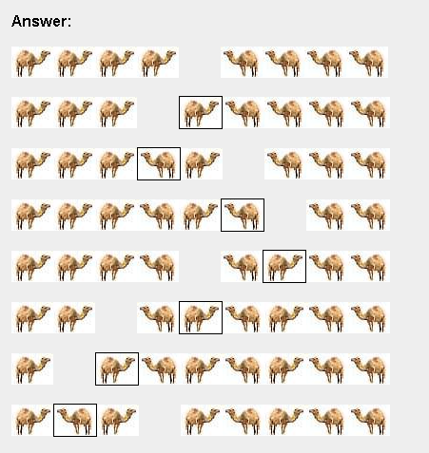
The Camels
Four Tasmanian camels traveling on a very narrow ledge encounter four Tasmanian camels coming the other way.
As everyone knows, Tasmanian camels never go backwards, especially when on a precarious ledge.
The camels will climb over each other, but only if there is a camel sized space on the other side.
The camels didn't see each other until there was only exactly one camel's width between the two groups.
How can all camels pass, allowing both groups to go on their way, without any camel reversing?
Solution:
(Show your workings)

Slide 5
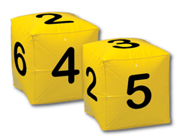
The Cubes
A corporate businessman has two cubes on his office desk.
Every day he arranges both cubes so that the front faces show the current day of the month.
What numbers are on the faces of the cubes to allow this?
Note: You can't represent the day "7" with a single cube with a side that says 7 on it. You have to use both cubes all the time. So the 7th day would be "07".
Solution:
(Show your workings)

Slide 6
The Cubes
A corporate businessman has two cubes on his office desk.
Every day he arranges both cubes so that the front faces show the current day of the month.
What numbers are on the faces of the cubes to allow this?
Note: You can't represent the day "7" with a single cube with a side that says 7 on it. You have to use both cubes all the time. So the 7th day would be "07".
Solution:
(Show your workings)
Answer:
Cube One has the following numbers: 0, 1, 2, 3, 4, 5
Cube two has the following numbers: 0, 1, 2, 6, 7, 8
The 6 doubles as a 9 when turned the other way around.
There is no day 00, but you still need the 0 on both cubes in order to make all the numbers between 01 and 09.
Alternate solutions are also possible e.g.
Cube One: 1, 2, 4, 0, 5, 6 Cube Two: 3, 1, 2, 7, 8, 0

Slide 7
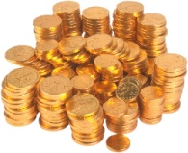
100 Gold Coins
Five pirates have obtained 100 gold coins and have to divide up the loot.
The pirates are all extremely intelligent, treacherous and selfish (especially the captain).
The captain always proposes a distribution of the loot. All pirates vote on the proposal, and if half the crew or more go "Aye", the loot is divided as proposed, as no pirate would be willing to take on the captain without superior force on their side.
If the captain fails to obtain support of at least half his crew (which includes himself), he faces a mutiny, and all pirates will turn against him and make him walk the plank. The pirates start over again with the next senior pirate as captain.
What is the maximum number of coins the captain can keep without risking his life?
Solution:
(Show your workings)

Slide 8
100 Gold Coins
Five pirates have obtained 100 gold coins and have to divide up the loot.
The pirates are all extremely intelligent, treacherous and selfish (especially the captain).
The captain always proposes a distribution of the loot. All pirates vote on the proposal, and if half the crew or more go "Aye", the loot is divided as proposed, as no pirate would be willing to take on the captain without superior force on their side.
If the captain fails to obtain support of at least half his crew (which includes himself), he faces a mutiny, and all pirates will turn against him and make him walk the plank. The pirates start over again with the next senior pirate as captain.
What is the maximum number of coins the captain can keep without risking his life?
Solution:
(Show your workings)
Answer: 98
The captain says he will take 98 coins, and will give one coin to the third most senior pirate and another coin to the most junior pirate. He then explains his decision in a manner like this...
If there were 2 pirates, pirate 2 being the most senior, he would just vote for himself and that would be 50% of the vote, so he's obviously going to keep all the money for himself.
If there were 3 pirates, pirate 3 has to convince at least one other person to join in his plan. Pirate 3 would take 99 gold coins and give 1 coin to pirate 1. Pirate 1 knows if he does not vote for pirate 3, then he gets nothing, so obviously is going to vote for this plan.
If there were 4 pirates, pirate 4 would give 1 coin to pirate 2, and pirate 2 knows if he does not vote for pirate 4, then he gets nothing, so obviously is going to vote for this plan.
As there are 5 pirates, pirates 1 & 3 had obviously better vote for the captain, or they face choosing nothing or risking death.

Slide 9
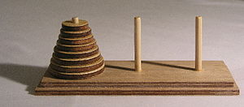
Tower of Hanoi
You have three wooden poles. On the first there are 3 discs of different sizes – with the biggest on the bottom and getting progressively smaller.
You can only move one disc at a time and you can never put a bigger disc on top of a smaller one.
Describe the steps to move all 3 rings to the right hand pole.
Now repeat with 4 discs.
And again with 5.
Solution:
(Show your workings)
Answer:

Slide 10
Tower of Hanoi
You have three wooden poles. On the first there are 3 discs of different sizes – with the biggest on the bottom and getting progressively smaller.
You can only move one disc at a time and you can never put a bigger disc on top of a smaller one.
Describe the steps to move all 3 rings to the right hand pole.
Now repeat with 4 discs.
And again with 5.
Solution:
(Show your workings)
Answer: (with 4 rings, 1st move to the middle)
11
2222
333333
=================================
2222
333333 11
=================================
333333 2222 11
=================================
11
333333 2222
=================================
11
2222 333333
=================================
11 2222 333333
=================================
2222
11 333333
=================================
11
2222
333333
=================================
For an even number of disks:
make the legal move between pegs A and B
make the legal move between pegs A and C
make the legal move between pegs B and C
repeat until complete
For an odd number of disks:
make the legal move between pegs A and C
make the legal move between pegs A and B
make the legal move between pegs B and C
repeat until complete

Slide 11


Camels & Bananas
A trader has 3 000 bananas that must be transported 1 000km across a desert to a market.
He has a single camel that can carry up to 1,000 bananas, however it needs to eat one banana for each km that it walks.
What is the largest number of bananas the trader can get to market?
Solution:
(Show your workings)
Answer:

Slide 12
Camels & Bananas
A trader has 3 000 bananas that must be transported 1 000km across a desert to a market.
He has a single camel that can carry up to 1,000 bananas, however it needs to eat one banana for each km that it walks.
What is the largest number of bananas the trader can get to market?
Solution:
(Show your workings)
Answer: 533
We always start with batches of 1000 bananas so after each ‘leg’ we want a multiple of 1000 bananas.
The first leg will involve carry 3 lots of bananas + 2 return trips, so there will be 5 trips. 1000 bananas / 5 trips = 200km.
By the second leg there will be 2000 bananas, with means 2 trips + 1 return trip. 1000 / 3 = 333km.
0km 200km 533km 1000km
2k (1k→) 0 0 0 Eat 200
2k (←200) 600 0 0 Eat 200
1k (1k →) 0 0 0 Eat 200
1k (← 200) 1200 0 0 Eat 200
0 (1k →) 2k 0 0 Eat 200
0 1k (1k →) 334 0 Eat 333
0 1k (← 333) 334 0 Eat 333
0 0 (1k →) 1001 0 Eat 333
0 0 1 (1k →) 0 Eat 477
0 0 1 533

